Slide 1

COCOMO Model
Project Management

Slide 2
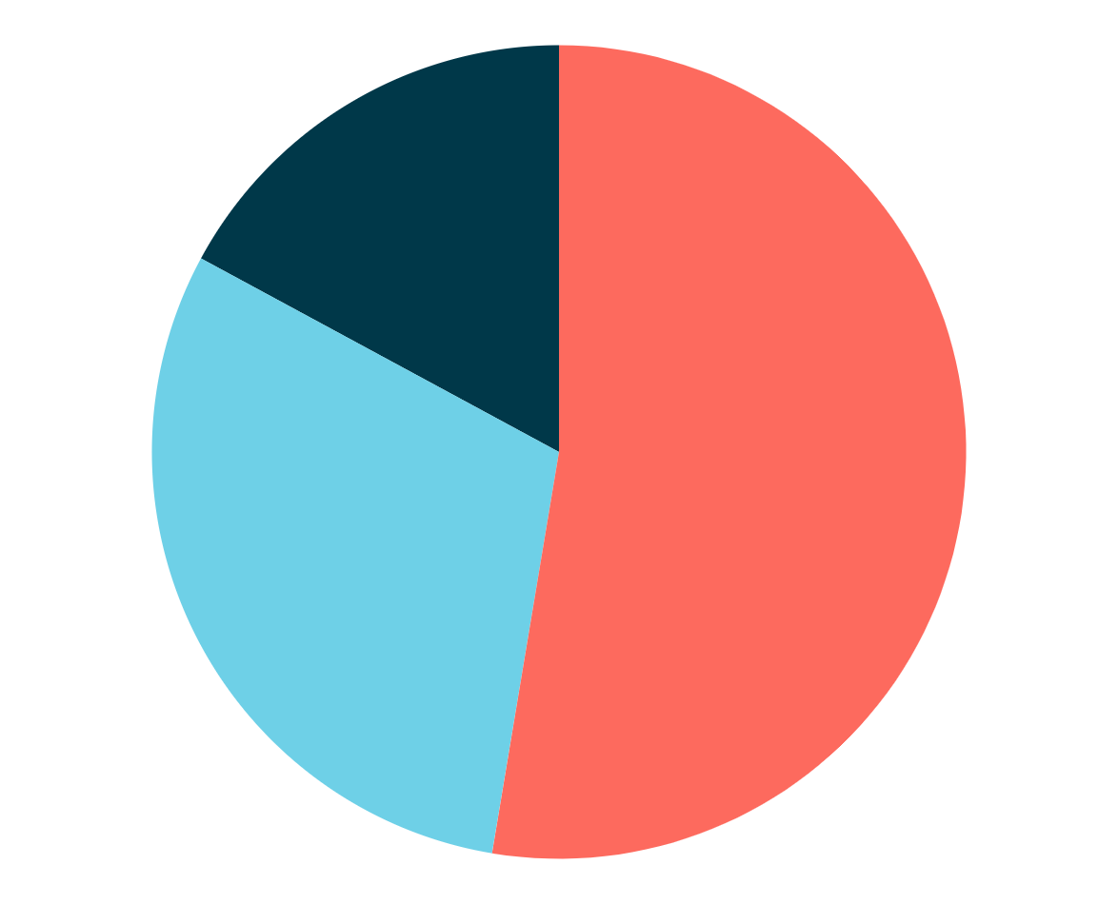
Innovative Visionary Project
An ambitious project aimed to revolutionize supply chain management
Underestimated Effort and Time
Inadequate Resource Allocation
Severe Budget Overruns
Compromised Quality

Slide 3

COCOMO MODEL
01
COCOMO stands for "Constructive Cost Model" and was developed by Barry Boehm in 1981.
Designed to calculate the cost of software development using empirical data and formulas.
Accurate estimation of cost, effort, and schedule is crucial for successful software project management.

Slide 4

01
Modes of COCOMO
02
03
02
Organic
Small teams with good experience working on straightforward projects.
Semi-Detached
Projects of intermediate size and complexity.
Embedded
Complex projects with stringent requirements and hardware constraints

Slide 5
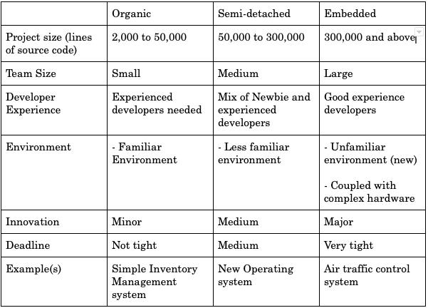

Slide 6
Stages Of COCOMO
03
Basic
Intermediate
Detailed

Slide 7
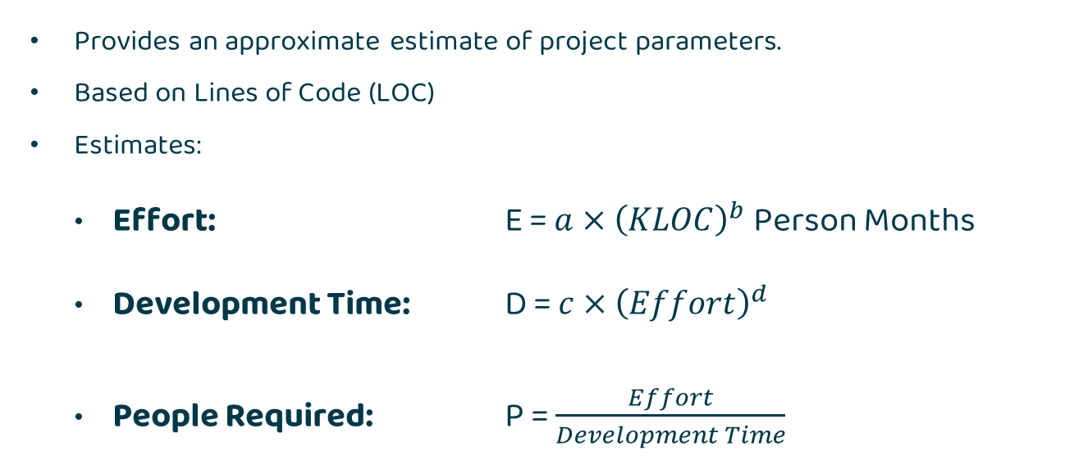
Basic COCOMO
Provides an approximate estimate of project parameters.
Based on Lines of Code (LOC)
Estimates:
Effort: E = $a×{\left(KLOC\right)}^{b}$ Person Months
Development Time: D = $c×{\left(Effort\right)}^{d}$
People Required: P = $\frac{Effort}{Development Time}$

Slide 8
Basic COCOMO
Where a, b, c & d are COCOMO constants for each mode
Mode | a | b | c | d
Organic | 2.4 | 1.05 | 2.5 | 0.38
Semi-Detached | 3.0 | 1.12 | 2.5 | 0.35
Embedded | 3.6 | 1.20 | 2.5 | 0.32

Slide 9
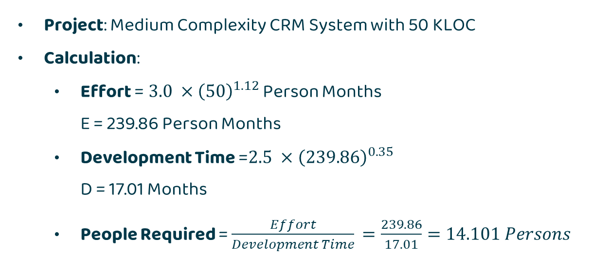
Example: Basic COCOMO
Project: Medium Complexity CRM System with 50 KLOC
Calculation:
Effort =$3.0 ×{\left(50\right)}^{1.12}$ Person Months
E = 239.86 Person Months
Development Time =$2.5 ×{\left(239.86\right)}^{0.35}$
D = 17.01 Months
People Required = $\frac{Effort}{Development Time}$ $=\frac{239.86}{17.01}=14.101 Persons$

Slide 10
Intermediate COCOMO
Intermediate COCOMO model refines the initial estimates obtained
Uses an additional set of 15 cost drivers based on various Software Engineering Attributes, called Effort Adjustment Factors (EAF):
Product Attributes
Hardware Attributes
Personnel Attributes
Project Attributes

Slide 11
Two Concepts
KLOC Calculation
Effort Adjustment Factors
Initial Cost Estimation based on KLOC as in Basic COCOMO
Effort Adjustment Factors multiplied in order to more accurately estimate

Slide 12
Effort Adjustment Factors are cost drivers that adjust project effort, categorized into Product, Hardware, Personnel, and Project Attributes, to enhance estimation accuracy.

Slide 13
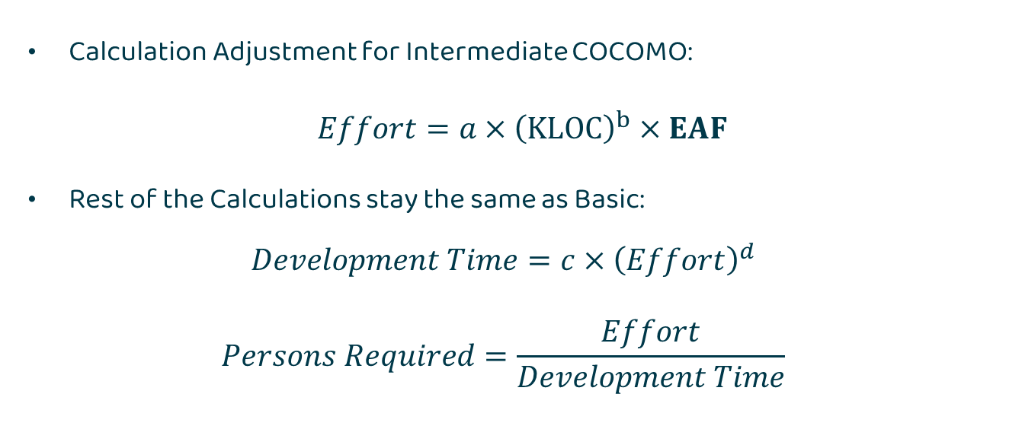
Intermediate COCOMO
Calculation Adjustment for Intermediate COCOMO:
$Effort=a×{\left(KLOC\right)}^{b}×EAF$
Rest of the Calculations stay the same as Basic:
$$Development Time=c×{\left(Effort\right)}^{d}$$
$$Persons Required=\frac{Effort}{Development Time}$$

Slide 14
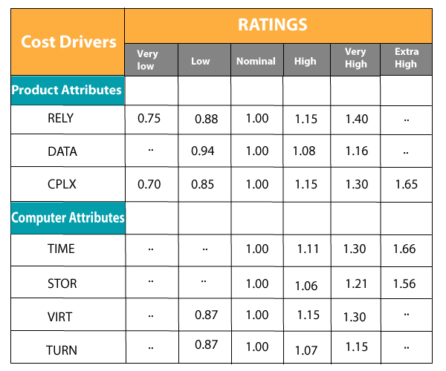
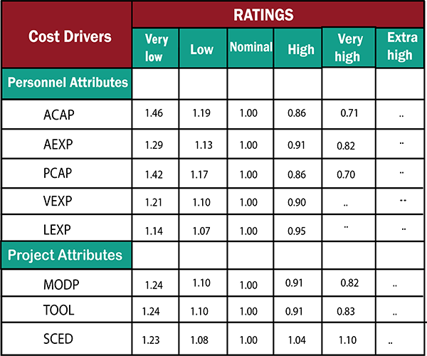
Effort Adjustment Factors

Slide 15
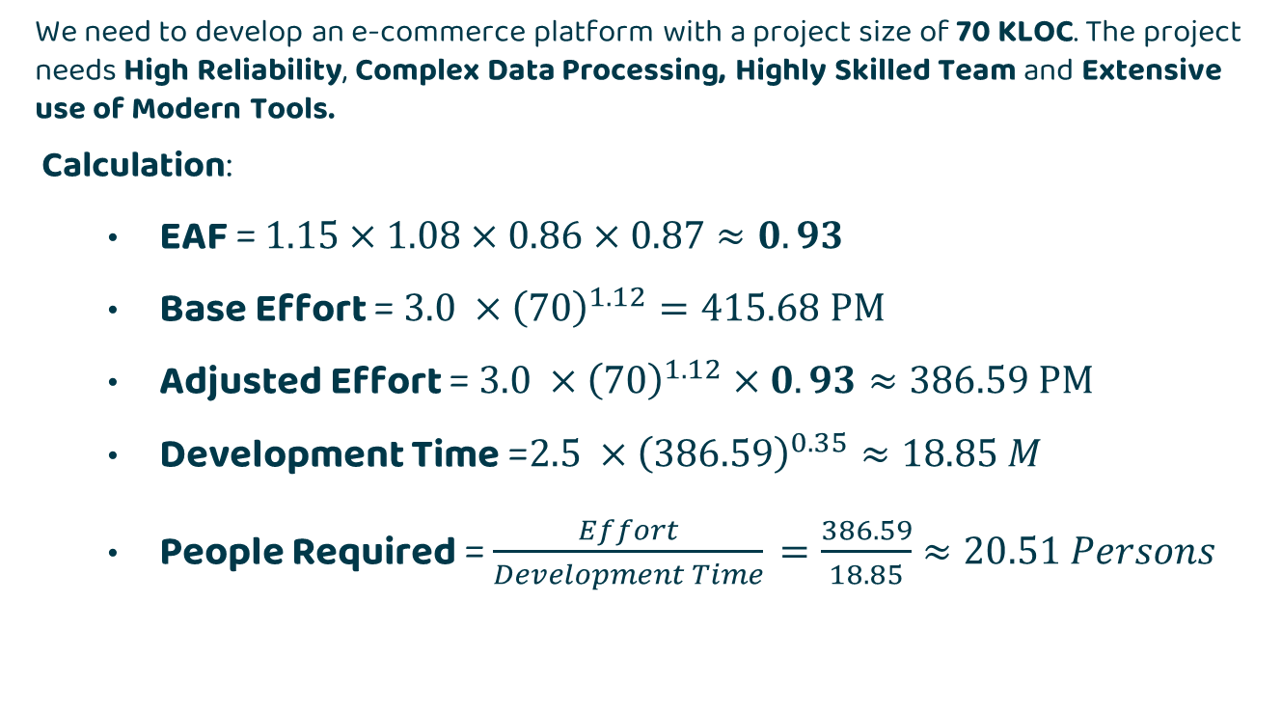
Example: Intermediate COCOMO
We need to develop an e-commerce platform with a project size of 70 KLOC. The project needs High Reliability, Complex Data Processing, Highly Skilled Team and Extensive use of Modern Tools.
Calculation:
EAF = $1.15×1.08×0.86×0.87≈0.93$
Base Effort =$3.0 ×{\left(70\right)}^{1.12}=415.68 PM$
Adjusted Effort =$3.0 ×{\left(70\right)}^{1.12}×0.93≈386.59 PM$
Development Time =$2.5 ×{\left(386.59\right)}^{0.35}≈18.85 M$
People Required = $\frac{Effort}{Development Time}$ $=\frac{386.59}{18.85}≈20.51 Persons$

Slide 16
Detailed COCOMO
Advanced COCOMO Model: Builds on Intermediate COCOMO.
Phase-Sensitive Estimation: Estimates effort for each phase of the project (e.g., design, coding, testing).
Comprehensive Cost Drivers: Incorporates additional cost drivers for more precision.
Highest Accuracy: Provides the most accurate estimates for large and complex projects.

Slide 17
Category | Cost Driver | Very Low | Low | Nominal | High | Very High | Extra High
Product | RELY | 0.75 | 0.88 | 1.00 | 1.15 | 1.40 | -
 | DATA | - | 0.94 | 1.00 | 1.08 | 1.16 | -
 | CPLX | 0.70 | 0.85 | 1.00 | 1.15 | 1.30 | 1.65
Hardware | TIME | - | - | 1.00 | 1.11 | 1.30 | 1.66
 | STOR | - | - | 1.00 | 1.06 | 1.21 | 1.56
 | VIRT | - | 0.87 | 1.00 | 1.15 | 1.30 | -
 | TURN | - | 0.87 | 1.00 | 1.07 | 1.15 | -
Personnel | ACAP | 1.46 | 1.19 | 1.00 | 0.86 | 0.71 | -
 | AEXP | 1.29 | 1.13 | 1.00 | 0.91 | 0.82 | -
 | PCAP | 1.42 | 1.17 | 1.00 | 0.86 | 0.70 | -
 | VEXP | 1.21 | - | 1.00 | 0.90 | - | -
 | LEXP | 1.14 | - | 1.00 | 0.95 | - | -
Project | MODP | 1.24 | 1.10 | 1.00 | 0.91 | 0.82 | -
 | TOOL | 1.24 | 1.10 | 1.00 | 0.91 | 0.83 | -
 | SCED | 1.23 | 1.08 | 1.00 | 1.04 | 1.10 | -
 | PVOL | - | 0.87 | 1.00 | 1.15 | 1.30 | -
 | PCON | - | 0.88 | 1.00 | 1.15 | 1.30 | -

Slide 18
Example: Detailed COCOMO
We need to develop enterprise software with a size of 100 KLOC. The project phases are:
Requirements: 30%
Design: 30%
Coding: 40%
Effort Adjustment Factors are
Platform Volatility (PVOL = 1.2)
Personnel Continuity (PCON = 0.9)
Database Size (DATA = 0.94)
Analyst Capability (ACAP = 0.86)

Slide 19
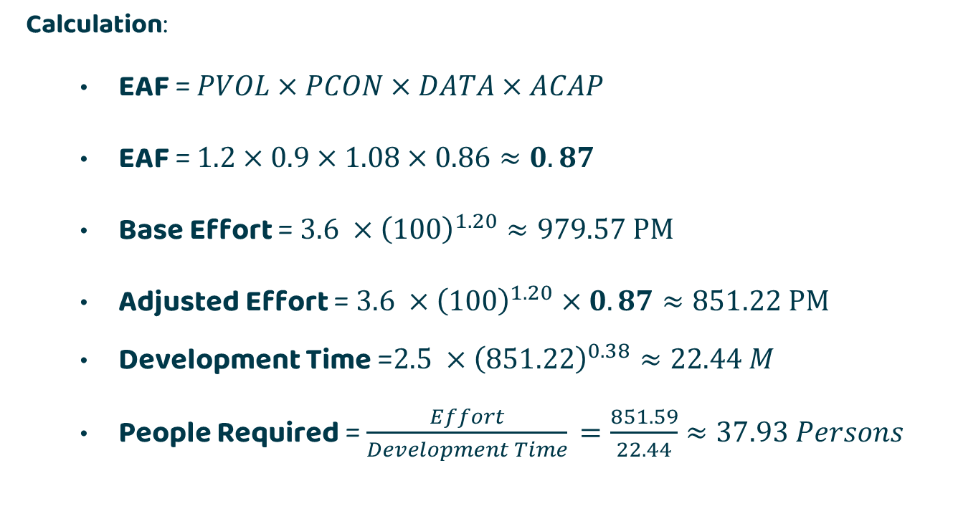
Example: Detailed COCOMO
Calculation:
EAF = $PVOL×PCON×DATA×ACAP$
EAF = $1.2×0.9×1.08×0.86≈0.87$
Base Effort =$3.6 ×{\left(100\right)}^{1.20}≈979.57 PM$
Adjusted Effort =$3.6 ×{\left(100\right)}^{1.20}×0.87≈851.22 PM$
Development Time =$2.5 ×{\left(851.22\right)}^{0.38}≈22.44 M$
People Required = $\frac{Effort}{Development Time}$ $=\frac{851.59}{22.44}≈37.93 Persons$

Slide 20
Example: Detailed COCOMO
Calculation:
We Have Total Effort: 851.22PM, Dev Time: 22.44, Persons: 37.93
We can now divide these costs for each phase as given:
Requirements 30%
Effort: 255.37 PM, Dev Time: 6.73 M, Persons: 37.93
Designing 30%
Effort: 255.37 PM, Dev Time: 6.73 M, Persons: 37.93
Coding 40%
Effort: 340.49 PM, Dev Time: 8.98 M, Persons: 37.93

Slide 21
Advantages Of Using COCOMO
Cost Estimations
Risk Mitigation
Better Planning
Resource Management

Slide 22
But There are Limitations to it ….
Assumes Static Requirements
Accuracy Depends on Historical Data
Ignores Modern Development Practices
Not Precise Enough

Slide 23

COCOMO II
Enhancing Software Development Cost Estimation

Slide 24

Need for COCOMO II
01

Slide 25

Introduction
02
Enhanced version of the original COCOMO developed at the University of Southern California.
It addresses the limitations of its predecessor and offers improved methodologies for estimating the cost of software development.
The accurate estimation of cost, effort, and schedule is crucial for successful software project management.

Slide 26
Stages for estimation:
03
Application composition
Post architecture
Early design

Slide 27
Application composition
03-a
External features of the system that the users will experience are designed.
Prototyping will typically be employed to do this.
Object Point Counting

Slide 28
Early design
03-b
Fundamental software structures are designed; such as the architecture, data models, and key algorithms, are designed
With larger, more demanding systems careful attention will be needed.
Function Points (FP): to quantify the size and complexity of a software applications functionality

Slide 29
Post architecture
03-c
Here the software structures undergo final construction, modification, and tuning to create a system that will perform as required.

Slide 30
Effort estimation formula
PM = A * Size * EM
PM is the estimated effort in person-months,
A is a constant value determined by the COCOMO II model,
Size is the size of the software project, typically measured in object points or EM is the effort multiplier, which adjusts the estimate to account for various productivity factors.

Slide 31
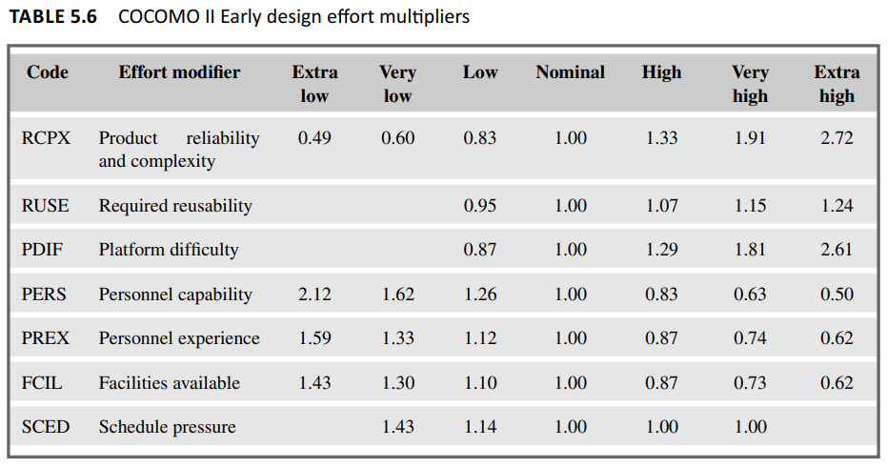
Effort Multipliers

Slide 32
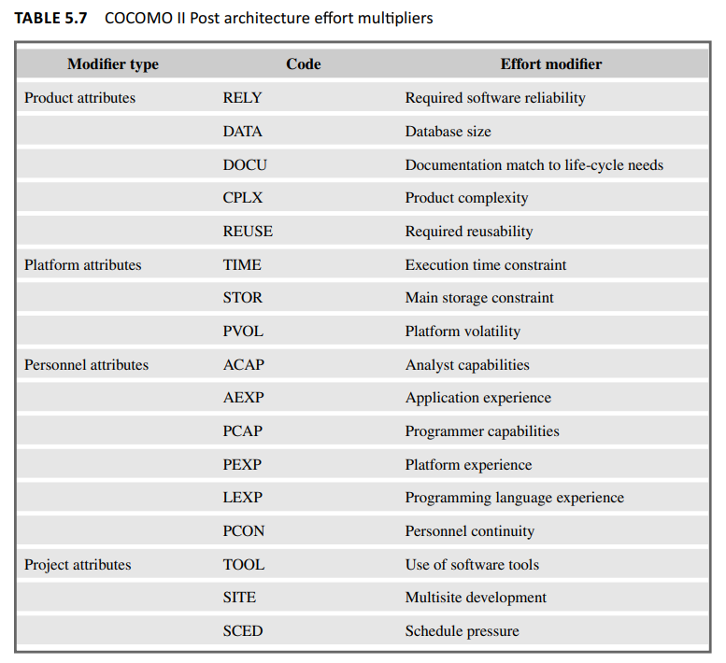
Effort multipliers are applied to the basic effort estimation formula to account for these factors, allowing for a more accurate estimation of the overall development effort.

Slide 33
We have a software project in the application composition stage estimated at 500 object points. With a constant value (A) of 2.5 and an effort multiplier (EM) set at 1.2, we can calculate the effort required
Calculation:
PM = A * Size * EM
Substitute the values
PM = 2.5 * 500 * 1.2 PM
= 1500 person-months

Slide 34

— Note
Implementing COCOMO 2 requires expertise in estimation techniques, making it challenging for organizations to adopt without proper training.

Slide 35

03
Best Practices for Using COCOMO

Slide 36
Best Practices
Recognize the Assumptions Underpinning the Model:
Customize the Model:
Understand the model’s assumptions about team experience, size, and complexity.
Adapt COCOMO to fit your project’s unique needs and industry standards.
Utilize Historical Data:
Verify and Validate:
Verify inputs and improve parameters with data from previous projects.
Compare estimates with actual project results and adjust as needed.

Slide 37

Comparison of COCOMO I and COCOMO II

Slide 38
Comparison
Aspect | COCOMO I | COCOMO II
Model Types | Basic, Intermediate, Detailed | Application Composition, Early Design, Post-Architecture
Basic | Founded on linear reuse formula | Based on the non-linear reuse formula
Project Categories | Organic, Semi-Detached, Embedded | No rigid categories; uses scaling factors and cost drivers
Parameters | 17 cost drivers | 22 effort multipliers, 5 scale factors
Flexibility | Less flexible, suitable for simpler projects | More flexible, adaptable to different development stages

Slide 39
Comparison
Aspect | COCOMO I | COCOMO II
Accuracy | Provides rough estimates | Provides more accurate estimates
Complexity | Simpler, easier to use | More complex, detailed
Model Framework | Development begins with the requirements assigned to the software | It follows a spiral type of Development.
Suitable Applications | Small to medium-sized projects | Medium to large, complex projects

Slide 40

Thank you
"In software development, accurate estimation is the cornerstone of successful projects."

Slide 41
—SPM
Hanzla Nouman
Laiba Binta Tahir
Arfah Ali

